Slide 1




EMBARGOED for 10:45 a.m. ET 11/17/19
Prospective comparison of ARNI with ARB Global Outcomes in heart failure with preserved ejectioN fraction (PARAGON-HF)
Comparison of outcomes in women and men
J McMurray, A Jackson, C Lam, M Redfield, I Anand, J Ge, M Lefkowitz, A Maggioni, F Martinez, M Packer, M Pfeffer, B Pieske, A Rizkala, S Sabarwal, A Shah, S Shah, V Shi, D van Veldhuisen, F Zannad, M Zile, M Cikes, E Goncalvesova, T Katova, A Kosztin, M Lelonek, N Sweitzer, O Vardeny,
B Claggett, P Jhund, S Solomon

Slide 2
Background
Although there are multiple effective drug and device therapies for HFrEF, there are none approved for the treatment of HFpEF, the most common type of HF in women. Hence, there is a greater “therapeutic deficit” in women, compared with men, with heart failure.
In PARAGON-HF, there were fewer primary endpoints in the sacubitril-valsartan group, compared with the valsartan group (894 vs. 1009), although the difference was of borderline statistical significance: rate ratio, 0.87 (95% CI 0.75 -1.01), P=0.059.
Of the12 pre-specified subgroup analyses in PARAGON-HF, only sex and LVEF appeared to modify the effect of sacubitril-valsartan, versus valsartan, on the primary outcome, with a more favorable treatment effect in women than in men (of the 4796 patients, analysed, 52% were women) .
In view of the potential importance of this finding, we further investigated the interaction between sex and the effect of treatment with sacubitril/valsartan.

Slide 3
PARAGON-HF: Design
Target patient population: ∼4,800 patients with symptomatic HF
(NYHA Class II–IV), LVEF ≥45%, LVH/LAE & elevated NT-proBNP
Double-blind treatment period
Active run-in period
Sacubitril/valsartan 200 mg BID
Screening
Valsartan
80 mg BID*
Sacub/valsartan
100 mg BID
Randomization 1:1
Valsartan 160 mg BID
On top of optimal background medications for co-morbidities (excluding ACEIs and ARBs)
up to 2 weeks
3–8 weeks
~240 weeks
Primary outcome: CV death and total
(first and recurrent) HF hospitalizations
(Event driven ~1,847 primary events)
https://clinicaltrials.gov/ct2/show/NCT01920711

Slide 4
Key baseline characteristics
Characteristic | Women (n=2479) | Men (n=2317)
Mean age (yr) | 74 | 72
Age ≥70 yr (%) | 72 | 61
NYHA class III/IV (%) | 23 | 17
KCCQ-CSS (score out of 100)* | 71 | 79
Mean LVEF (%) | 59 | 56
Median NT-proBNP (pg/ml) | 836 | 954
Mean systolic BP (mmHg) | 131 | 130
Mean eGFR (ml/min/1.73m²) | 60 | 65
eGFR <60 ml/min/1.73m² (%) | 53 | 44
Atrial fibrillation/flutter on ECG (%) | 29 | 36
*a lower score is worse

Slide 5
Baseline characteristics/treatments
Characteristic | Women (n=2479) | Men (n=2317)
History of hypertension (%) | 97 | 95
History of myocardial infarction (%) | 16 | 30
Diabetes (%) | 40 | 46
Prior heart failure hospitalization (%) | 46 | 49
Treatments
Diuretic | 95 | 96
ACE-inhibitor or ARB at screening | 87 | 86
Beta-blocker | 80 | 79
MRA | 24 | 28
Calcium channel blocker | 35 | 34
Digoxin | 10 | 9

Slide 6
Primary outcome

Slide 7
Total HF hospitalizations and CV death
Including first and repeat hospitalizations
Women
Rate Ratio 0.73 (0.59, 0.90)
Men
Rate Ratio 1.03 (0.84, 1.25)
Valsartan
Valsartan
Sac/val
Sac/val

Slide 8
Components of primary outcome
Heart failure hospitalizations (first and repeat)
Women
RR 0.67 (0.53, 0.85)
Men
RR 1.07 (0.85, 1.34)
Valsartan
Valsartan
Sac/val
Sac/val

Slide 9
Components of primary outcome
Cardiovascular death
Women
HR 1.02 (0.76, 1.36)
Men
HR 0.90 (0.70, 1.17)
Valsartan
Valsartan
Sac/val
Sac/val

Slide 10
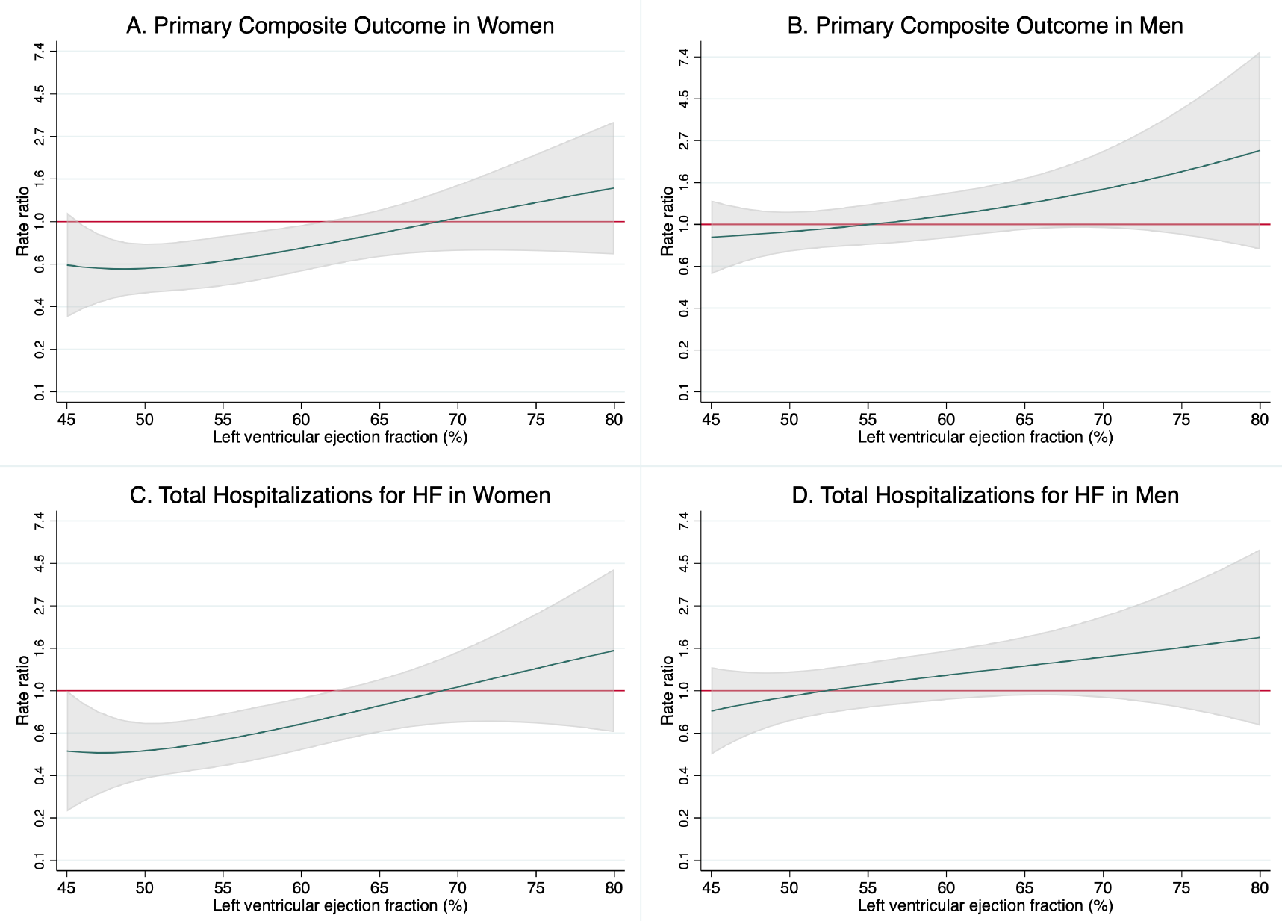
Treatment effect according to
baseline LVEF
Primary composite outcome
Women
Men
Continuous HR
Valsartan
better
RR=1 (unity)
95%CI
Sac/val
better

Slide 11
Treatment effect according to
baseline LVEF
Heart failure hospitalizations (first and repeat)
Women
Men

Slide 12
Secondary outcomes
In order of hierarchical testing

Slide 13
Mean change in KCCQ-CSS
(baseline to 8 months)
Women
Men
valsartan
sac/val
valsartan
sac/val
Change in score (points)
Change in score (points)
Difference at month 8:
-0.6 (-2.1, 0.8)
Difference at month 8:
2.8 (1.3, 4.3)
P int.= 0.001

Slide 14


Change in NYHA class
(baseline to 8 months)
Valsartan
Sacubitril/valsartan
Women
Men
OR 0.96
(0.58, 1.59)
OR 1.72
(1.07, 2.76)
OR 0.64
(0.39, 1.06)
OR 1.34
(0.80, 2.23)
%
%
P int.= 0.26
(deterioration)
P int.= 0.44
(improvement)
Deterioration
Improvement
Deterioration
Improvement

Slide 15
Worsening kidney function endpoint
Composite of: Sustained* ≥50% reduction in eGFR, end-stage renal disease (ESRD) or death from renal causes
 | Valsartan No. (%) | Sac/val No. (%) | Hazard ratio (95%CI)
Women (n=2479) | 32 (2.6) | 16 (1.3) | 0.49 (0.27, 0.89)
Men (n=2317) | 49 (2.8) | 17 (1.5) | 0.53 (0.29, 0.95)
P int.= 0.90
ESRD consisted of sustained eGFR below 15 ml/min/1.73m², sustained dialysis or kidney transplantation *Sustained = 28 days or more

Slide 16
All-cause mortality
Women
HR 0.96 (0.77, 1.20)
Men
HR 0.97 (0.80-1.19)
Valsartan
Valsartan
Sac/val
Sac/val

Slide 17
Laboratory measures,
tolerability and safety

Slide 18
Safety/adverse events (AEs)
Women
Men
 | Val. | Sac/val. |  | Val. | Sac/val. | P-value for inter.
AE/abnormality of interest (%)
Hypotension | 9.9 | 15.7 |  | 11.7 | 15.9 | 0.38
Creatinine ≥2.5 mg/dl | 2.4 | 2.3 |  | 6.9 | 5.9 | 0.81
Creatinine ≥3.0 mg/dl | 0.8 | 1.0 |  | 2.6 | 2.2 | 0.51
Potassium ≥5.5 mmol/l | 13.7 | 12.9 |  | 16.6 | 13.4 | 0.25
Potassium ≥6.0 mmol/l | 4.1 | 2.8 |  | 4.3 | 3.4 | 0.65
Angioedema | 0.2 | 0.9 |  | 0.1 | 0.3 | 0.88
Target dose of study drug (%) | 84.5 | 80.6 |  | 85.7 | 83.3 | -
Study drug discontinuation (%)* | 27.7 | 27.1 |  | 25.6 | 23.5 | -
*Discontinued for reasons other than death

Slide 19
Summary and conclusions
As compared with valsartan, sacubitril-valsartan seemed to reduce the risk of heart failure hospitalization more in women than in men, but the effects on KCCQ, NYHA class and worsening kidney function were not greater in women.
Therefore, not clear whether this was a chance finding or a real difference.
Several potential biological mechanisms may explain it e.g. a deficit in cGMP-PKG signalling in post-menopausal women and more systolic dysfunction in women than men in the EF range 40 to ~65%.
Conversely, there may be more male “non-responders” because of alternative pathology (e.g. cardiac amyloidosis) and or the active comparator (valsartan) may have been more effective in men than women.
The possible modification of the effect of sacubitril/valsartan by sex requires further investigation.

Slide 20

Circulation. 2019; [published online ahead of print]. DOI: 10.1161/CIRCULATIONAHA.119.044491
Effects of sacubitril-valsartan, versus valsartan, in women
compared to men with heart failure and preserved ejection
fraction: Insights from PARAGON-HF
John J.V. McMurray, MD; Alice M. Jackson, MBChB; Carolyn S.P. Lam, MB, BS, PhD;
Margaret M. Redfield, MD; Inder S. Anand, MD; Junbo Ge, MD; Marty P. Lefkowitz, MD;
Aldo P. Maggioni, MD; Felipe Martinez, MD; Milton Packer, MD; Marc A. Pfeffer, MD, PhD;
Burkert Pieske, MD; Adel R. Rizkala, Pharm.D; Shalini V. Sabarwal, Pharm.D; Amil M. Shah, MD;
Sanjiv J. Shah, MD; Victor C. Shi, MD; Dirk J. van Veldhuisen, MD; Faiez Zannad, MD; Michael R. Zile MD; Maja Cikes, MD, PhD; Eva Goncalvesova, MD; Tzvetana Katova, MD; Anamaria Kosztin, MD, PhD; Malgorzata Lelonek, MD; Nancy Sweitzer, MD; Orly Vardeny, PharmD, MS; Brian Claggett, PhD; Pardeep S. Jhund MD; Scott D. Solomon, MD
Circulation
https://www.ahajournals.org/doi/10.1161/CIRCULATIONAHA.119.044491

Slide 21
Back-up/extra slides

Slide 22
Clinically meaningful change
(≥5 points) in KCCQ-CSS
Valsartan
Sacubitril/valsartan
Women
Men
OR 1.04
(0.79, 1.36)
OR 1.09
(0.81,1.46)
OR 0.82
(0.60, 1.11)
OR 1.57
(1.14, 2.15)
%
%
P int.= 0.28
(decrease)
P int.= 0.11 (increase)
Decrease
Increase
Decrease
Increase

Slide 23
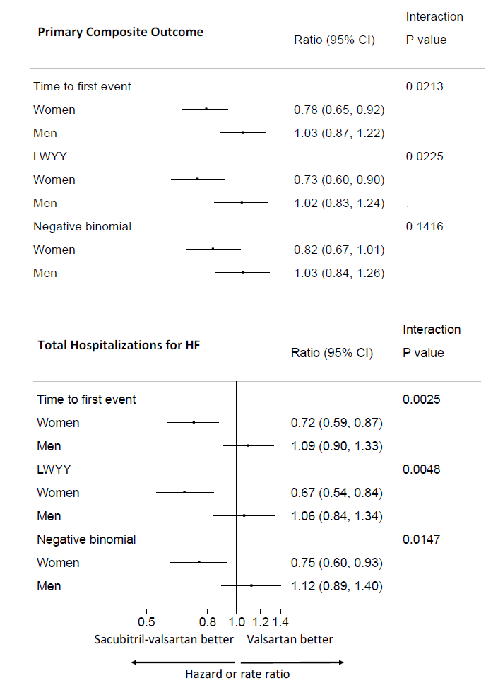
Time-to-first event and
recurrent events analyses
Primary composite outcome
Hospital admissions (1st and repeat)
Time to first
Time to first
LWYY
LWYY
Negative binomial
Negative binomial

